Slide 1




Arghya Pal
Ph.D, M. Tech (Gold Medalist),
PostDoc Research Fellow,
Monash University and Harvard University
Beyond Full Supervision
CVPR Doctoral Consortium, CVPR 2020
WACV Doctoral Consortium, WACV 2021
Academic Preparation:
Bachelor of Technology, West Bengal University of Technology (WBUT)
Master of Technology, Goa University
Ph.D., IIT Hyderabad
PostDoc, Harvard University and Monash University
Recognitions:
Intel Ph. D. Research Fellow: Duration 2015-2020; Topic: Predicting the Data Itself - Reliable Data Generation using Alternate Supervision; PI: Dr. Vineeth N B, IIT HYderabad
Best Researcher Award (Ph. D. category), IIT Hyderabad, Year 2018
Goa Govt. Merit Stipend, Gold Medal (GU)
Reviewer: T-PAMI, T-PR, CVPR, NeurIPS, ICCV, AAAI, WACV
Staff Recognition 2020, $834 Monetary Award, Monash University.
Exposures:
Grants from Microsoft, Intel, Google Research
Research Visits: AIST JAPAN, University of Tokyo, Monash University
Workshops: GIAN, Conformal Prediction, NCC
Internships at TCS, Adobe, Intel
PhD Representative (CSE Dep.) 2016-17

Slide 2
Generative Adversarial Networks
Outline
Generative Models
High-level introduction to GANs
Math background
Drawbacks of vanilla GANs
Variations of GANs
Evaluation of GAN

Slide 3
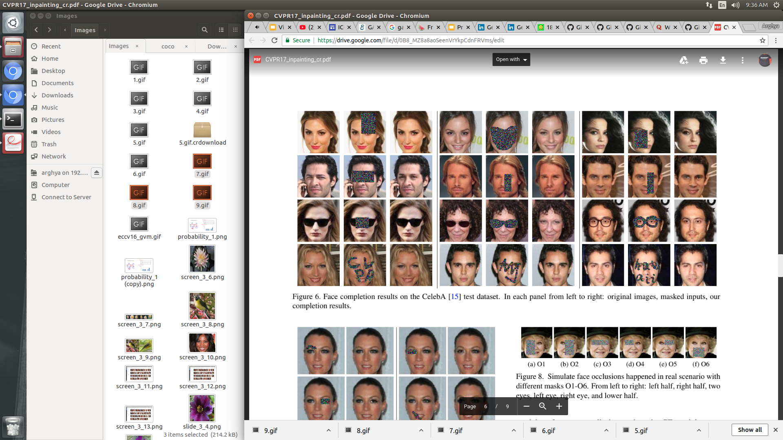
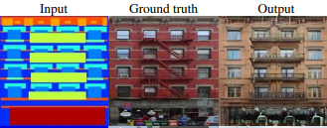
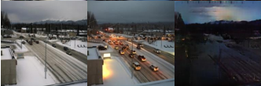
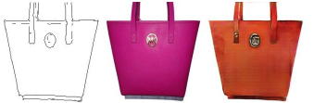
Power of Generative Adversarial Networks
Image Completion using GAN
Image to Image Translation
Source: Generative Face Completion
Source: Image2Image Translation with CGAN

Slide 4
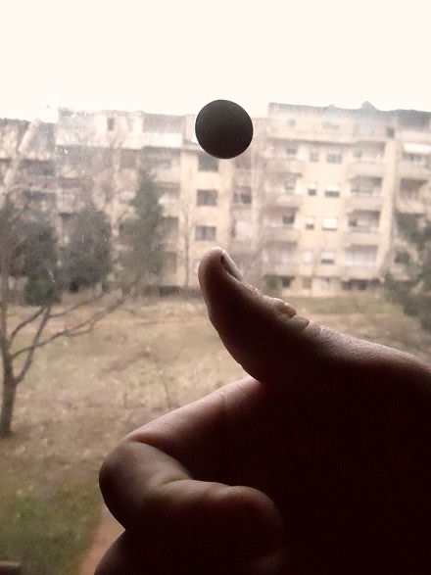
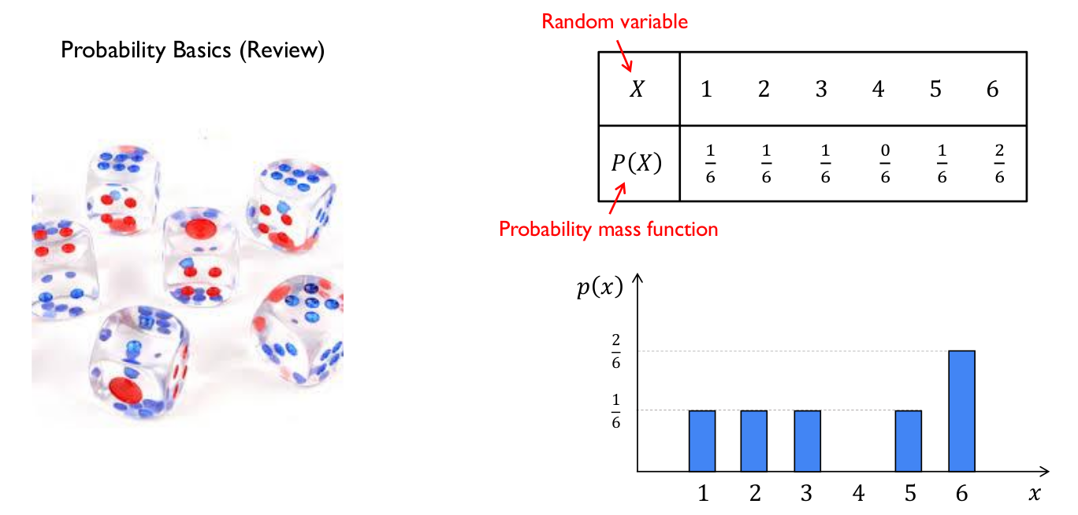
Warm-up
Probability Distribution
Experiment, doing a coin toss
Observations/Events, Head or Tail
Sample Space, the complete set, S = {H, T}, of observations
Random Variables, X = {0, 1}, sample space to real numbers.
a measurable function that maps from the sample space to the real numbers.
Pls memorize the term Random Variable
Source: https://www.slideshare.net/YunjeyChoi/generative-adversarial-networks-75916964

Slide 5
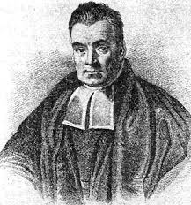
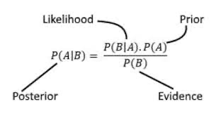
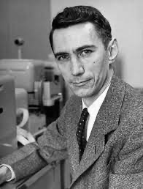
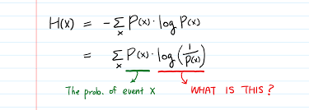
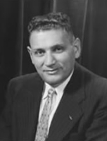
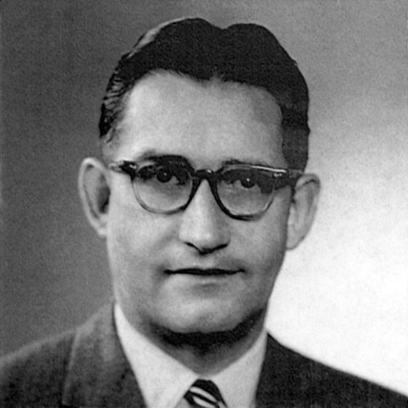
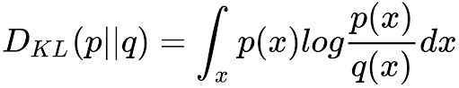
Warm-up
Probability Distribution
Source: https://www.slideshare.net/YunjeyChoi/generative-adversarial-networks-75916964

Slide 6
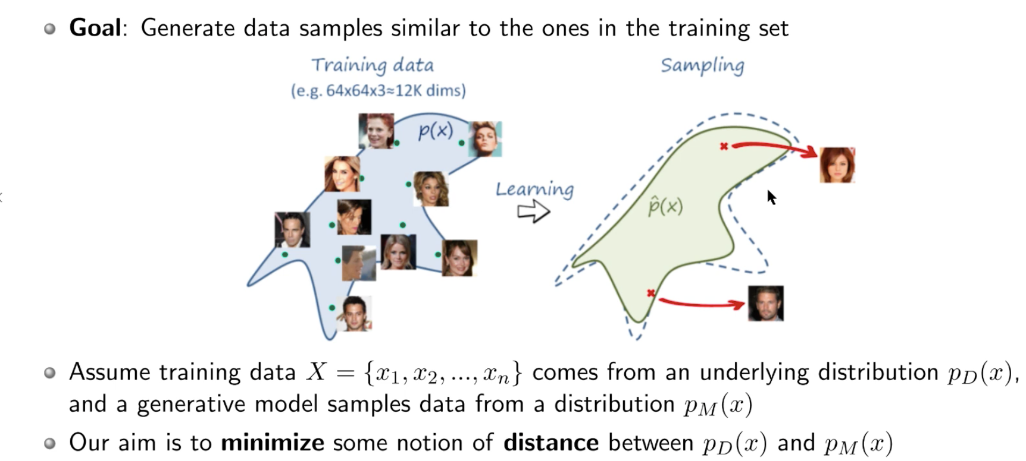
Generative Modeling
Source: https://www.slideshare.net/YunjeyChoi/generative-adversarial-networks-75916964

Slide 7
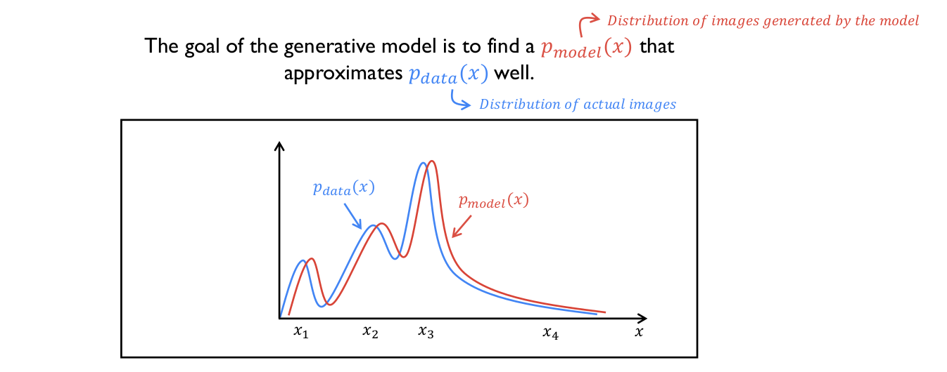
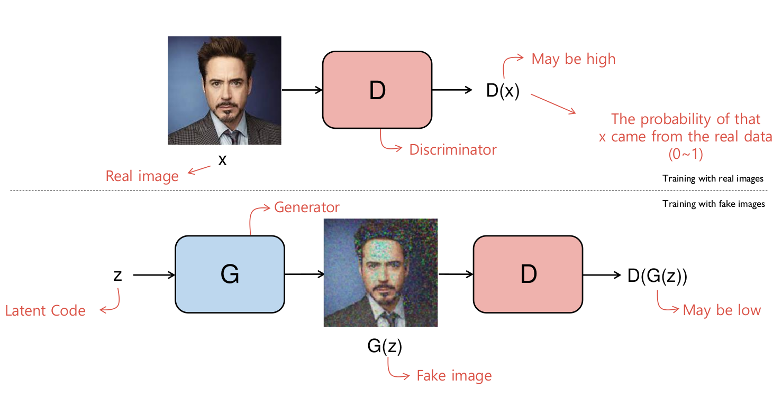
High-level introduction to GANs
The generative model is pitted against an adversary
A discriminative model that learns to determine whether a sample is from the model distribution or the data distribution

Slide 8
Generative Adversarial Networks
Outline
Generative Models
High-level introduction to GANs
Math background
Drawbacks of vanilla GANs
Variations of GANs
Evaluation of GAN

Slide 9
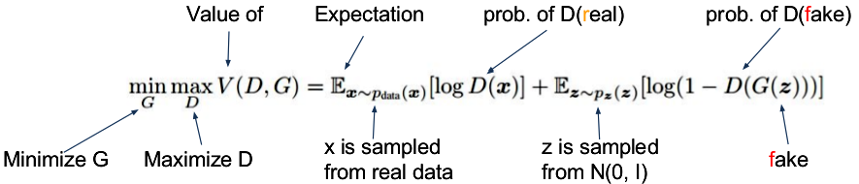
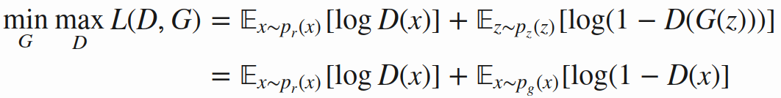
Generative Adversarial Network : 2 player game
Payoff from generator to discriminator
Payoff unchanged at equilibrium point - NASH point
The move between two players

Slide 10
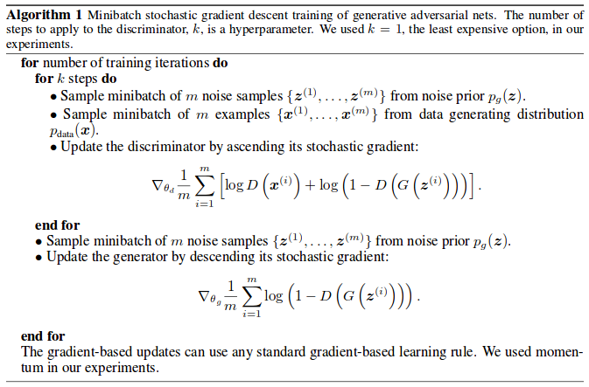
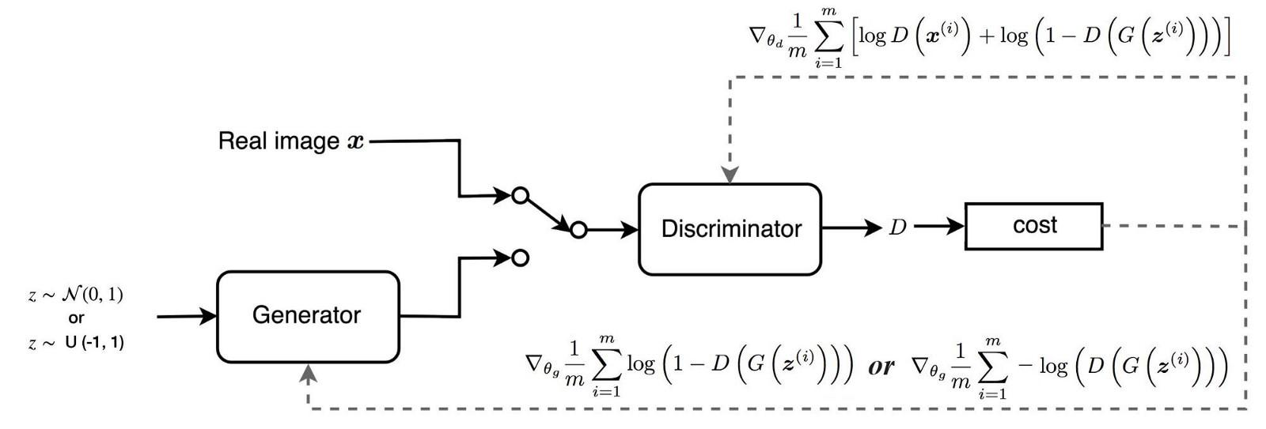
GAN Training Algorithm

Slide 11
Drawbacks of vanilla GANs
No guarantee to equilibrium
Two models are trained simultaneously to find a Nash equilibrium to a two-player non-cooperative game
However, each model updates its cost independently with no respect to another player in the game
Updating the gradient of both models concurrently cannot guarantee a convergence.

Slide 12
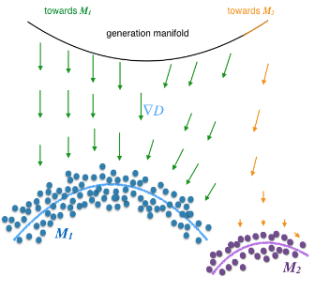
Drawbacks of vanilla GANs
Mode collapsing
Oscillation
No indicator when to finish
Lack of proper evaluation metric
Source: Improved Techniques for Training GANs

Slide 13
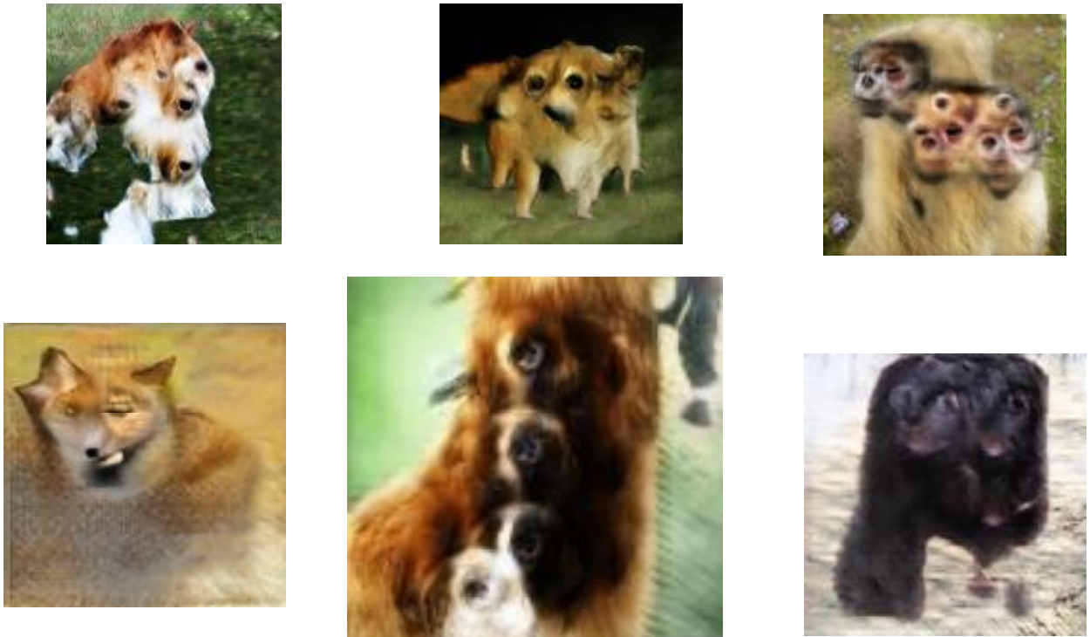
Drawbacks of vanilla GANs
Problems with Counting

Slide 14
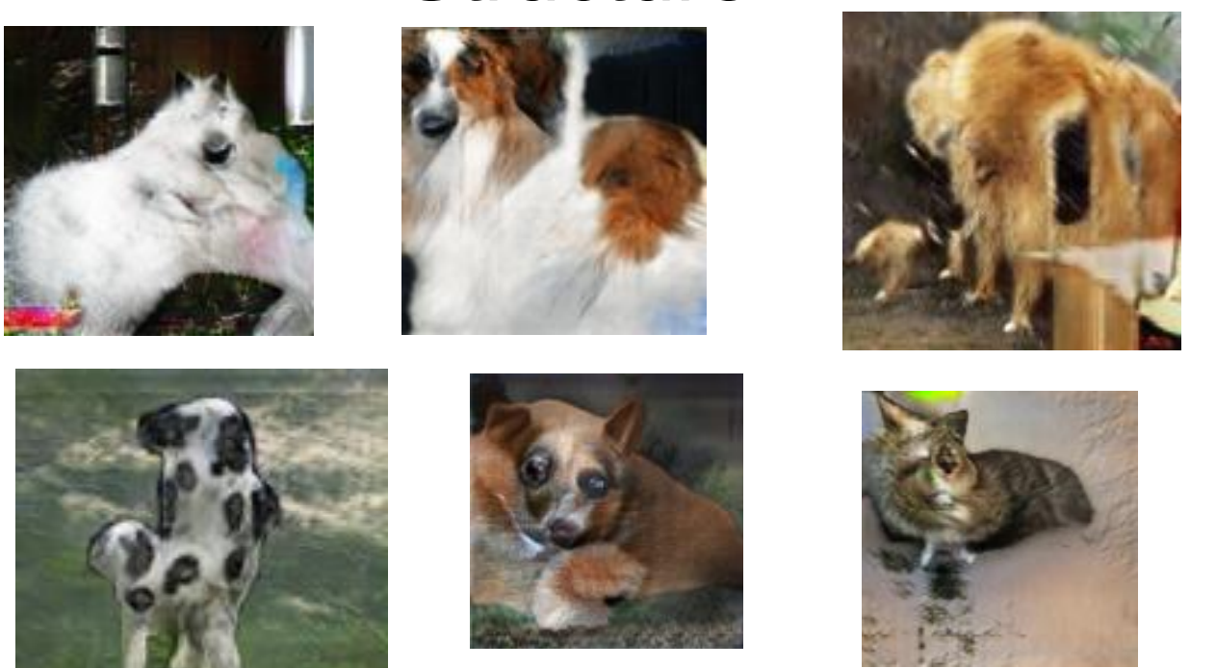
Drawbacks of vanilla GANs
Problems with Global Structure

Slide 15
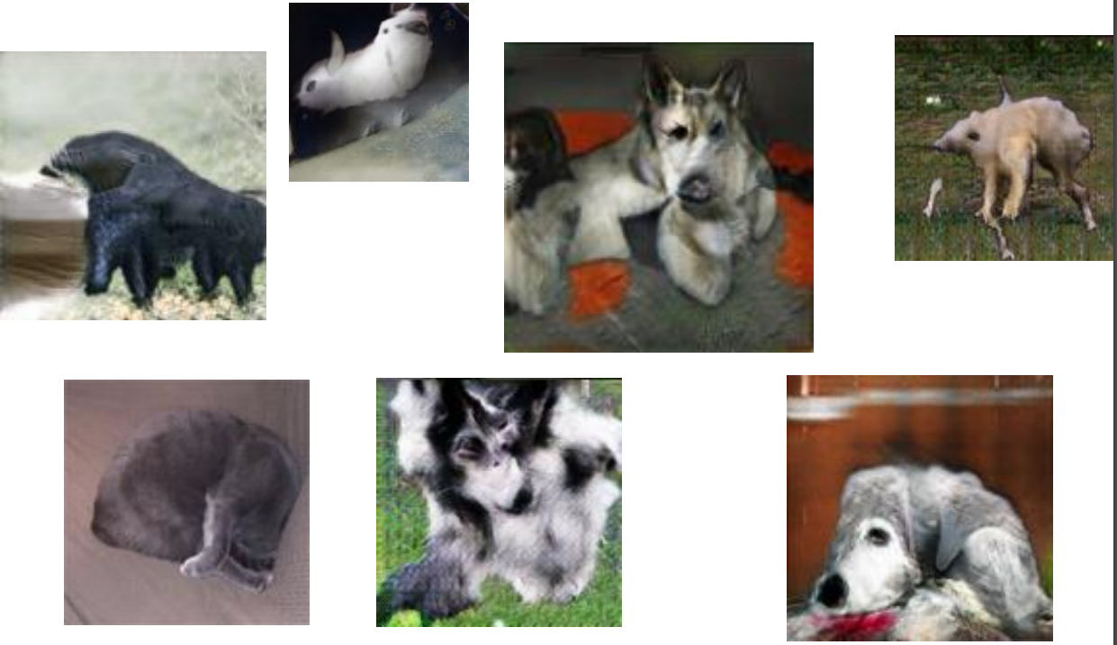
Drawbacks of vanilla GANs
Problems with Perspective

Slide 16
Generative Adversarial Networks
Outline
Generative Models
High-level introduction to GANs
Math background
Drawbacks of vanilla GANs
Variations of GANs
Evaluation of GAN

Slide 17
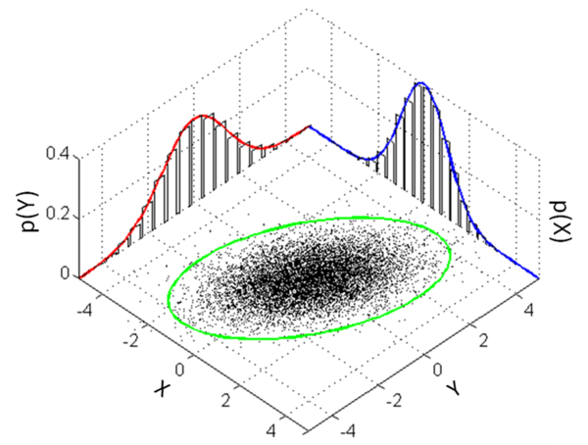
Variations of GANs
Marginal distribution learning using GAN; i.e. P(x)
Vanilla GAN, DCGAN, video generation, 3D shape modeling
Conditional distribution learning using GAN; i.e. P(x|y)
Conditional GAN, InfoGAN, Text to Image Synthesis, StarGAN, CycleGAN
Joint distribution learning using GAN; i.e. P(x , y)
CoGAN, TripleGAN, ADP

Slide 18
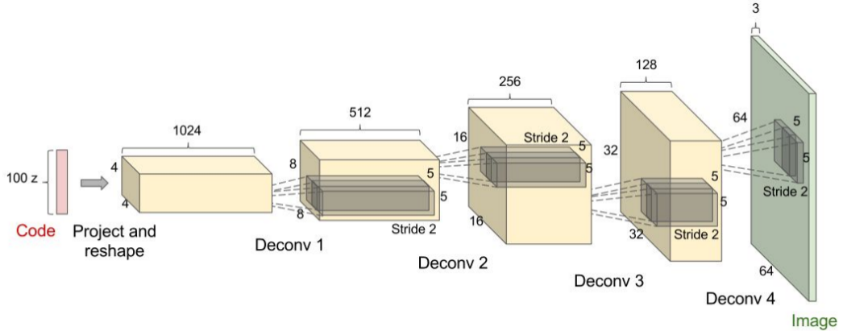
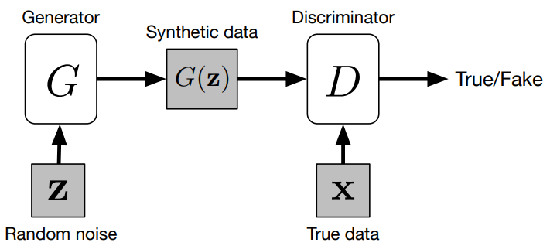
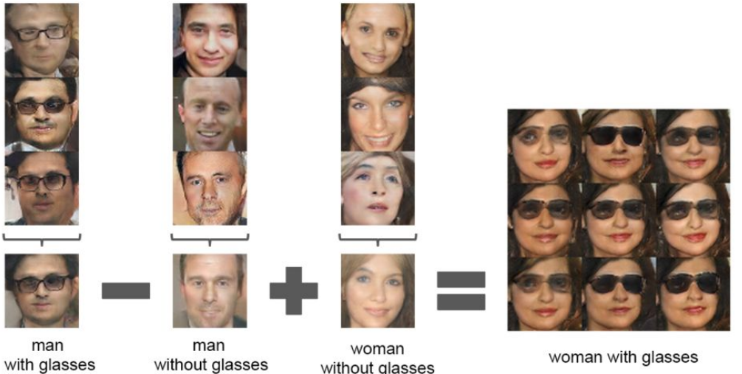
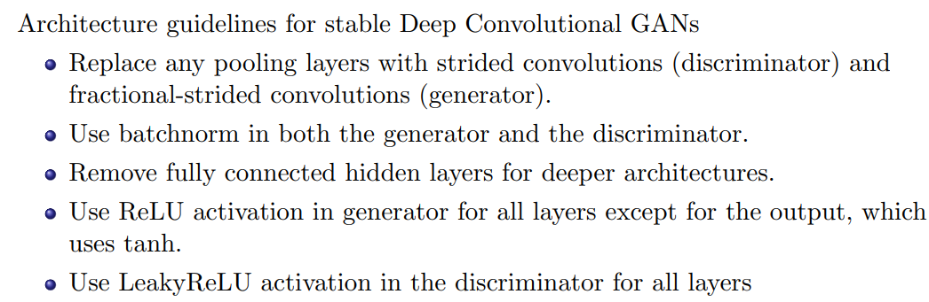
Marginal Distribution Learning, i.e. P(x)

Slide 19
Variations of GANs
Marginal distribution learning using GAN; i.e. P(x)
Vanilla GAN, DCGAN, video generation, 3D shape modeling
Conditional distribution learning using GAN; i.e. P(x|y)
Conditional GAN, InfoGAN, Text to Image Synthesis, StarGAN, CycleGAN
Joint distribution learning using GAN; i.e. P(x , y)
CoGAN, TripleGAN, ADP

Slide 20
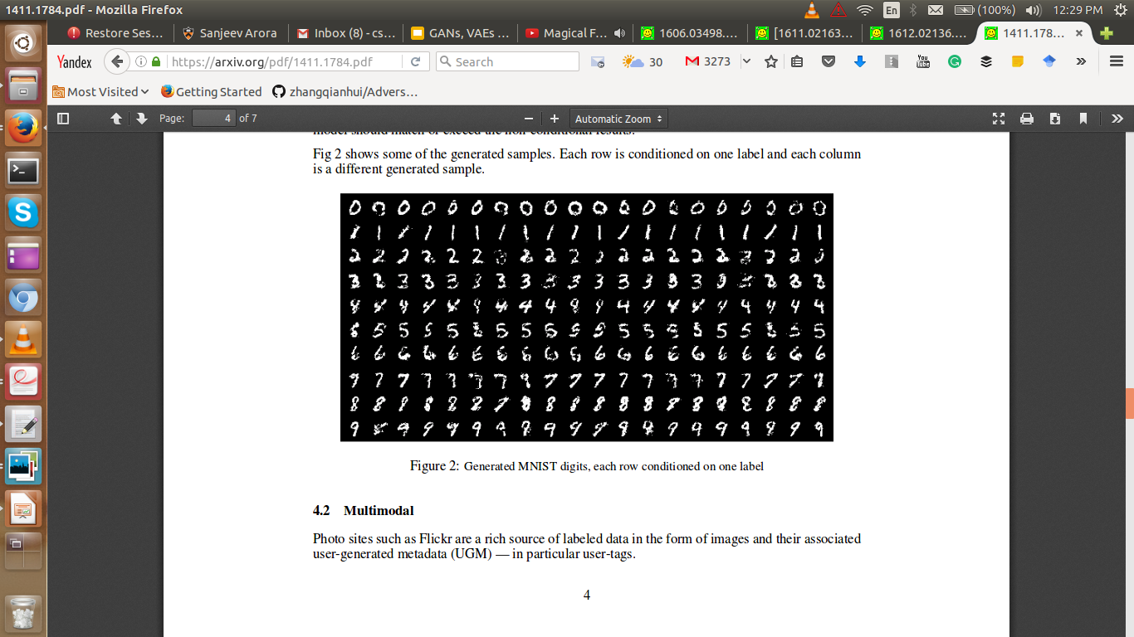
Condition on class label - Conditional GAN

Slide 21
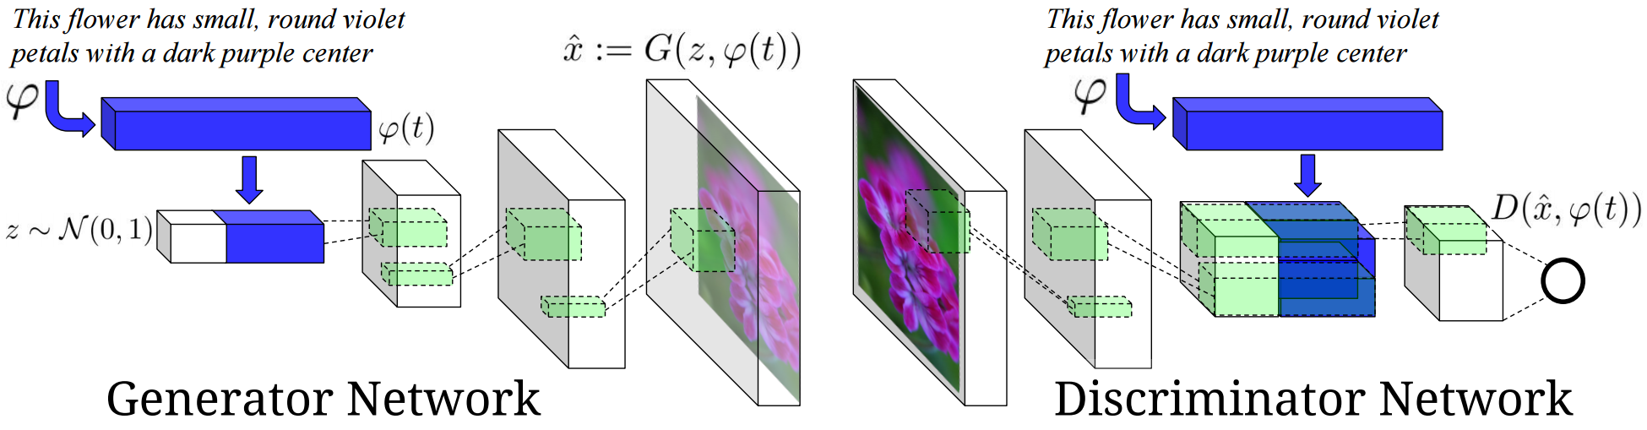
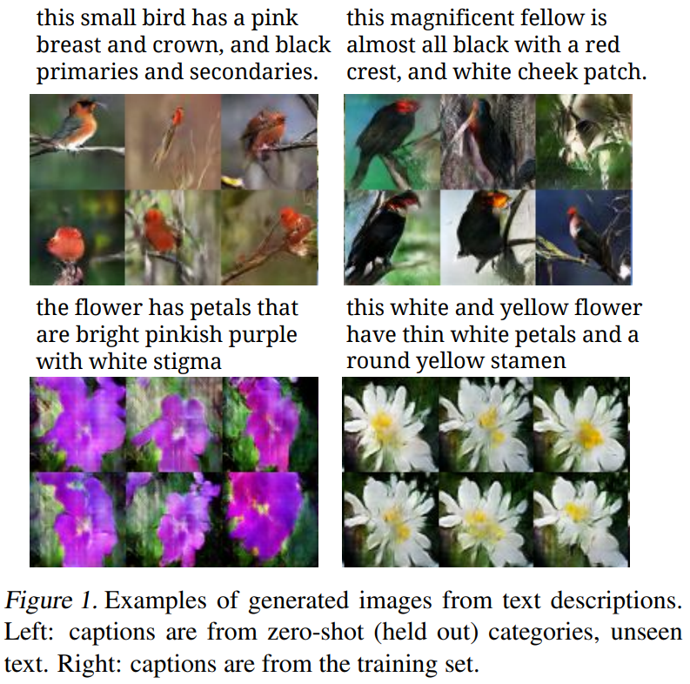
Condition on data from different modality - Text to Image
Source: Generative Adversarial Text to Image Synthesis

Slide 22
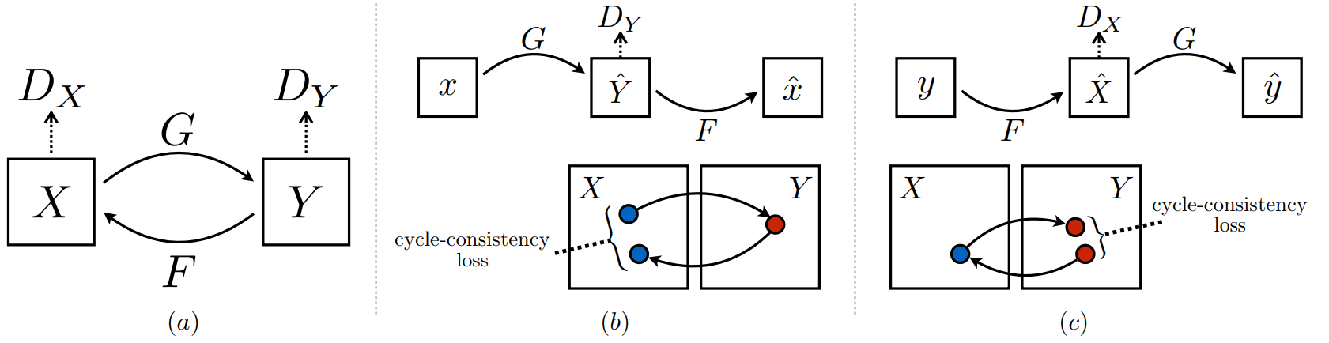
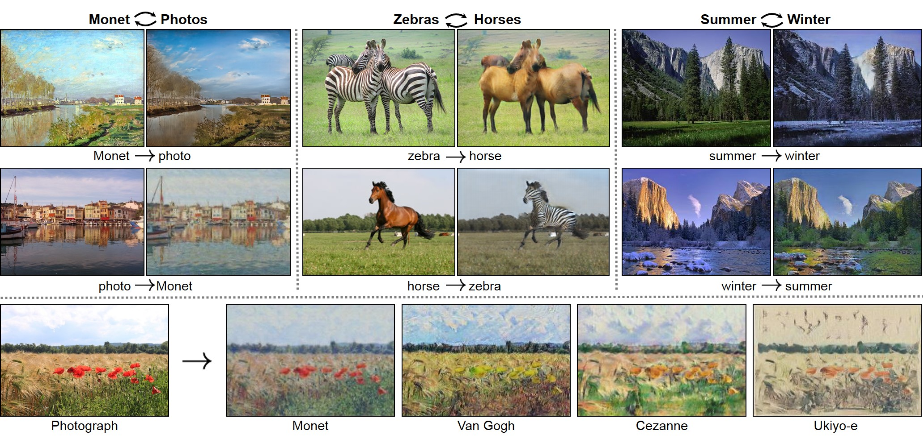
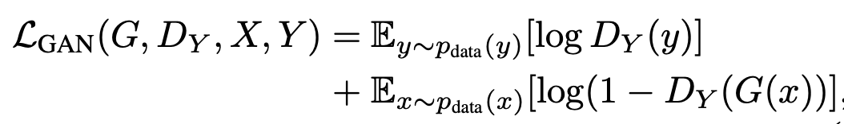
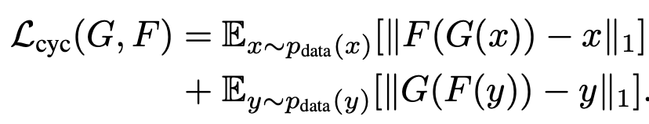
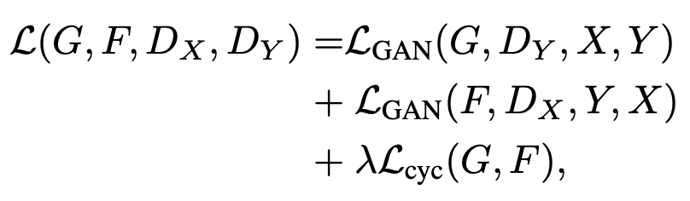
Conditioned on the Image: CycleGAN
Source: CycleGAN

Slide 23
Variations of GANs
Marginal distribution learning using GAN; i.e. P(x)
Vanilla GAN, DCGAN, video generation, 3D shape modeling
Conditional distribution learning using GAN; i.e. P(x|y)
Conditional GAN, InfoGAN, Text to Image Synthesis, StarGAN, CycleGAN
Joint distribution learning using GAN; i.e. P(x , y)
CoGAN, TripleGAN, ADP

Slide 24
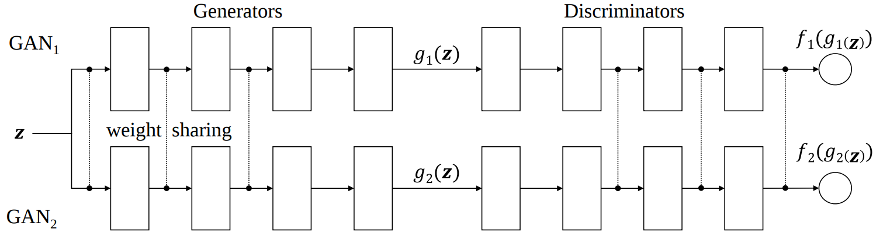
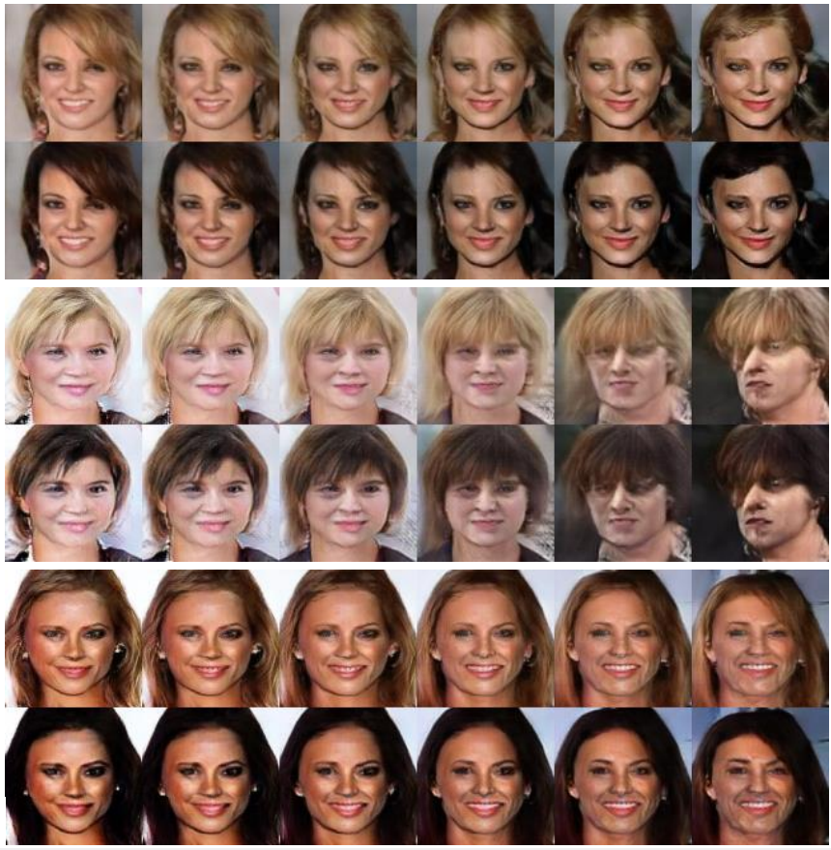
From marginal distribution - CoGAN
Each pair
First row: Blond hair from GAN₁
Second row: Black hair from GAN₂
Source: Coupled Generative Adversarial Networks

Slide 25
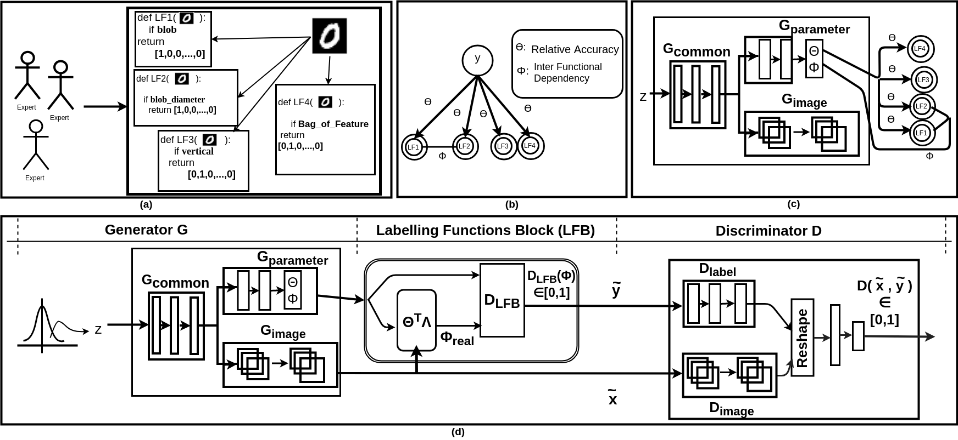
Using the method of distant supervision - Adversarial Data Programming
Source: Adversarial Data Programming

Slide 26
Generative Adversarial Networks
Outline
Generative Models
High-level introduction to GANs
Math background
Drawbacks of vanilla GANs
Variations of GANs
Evaluation of GAN

Slide 27
Inception Score
It uses a pre-trained neural network - the Inception Net trained on the ImageNet (a dataset)
Highly classifiable and diverse with respect to class labels
It measures the average KL divergence between;
the conditional label distribution p(y|x) of samples
the marginal distribution p(y) obtained from all the samples
It favors low entropy of p(y|x) but a large entropy of p(y)

Slide 28
Fréchet inception distance

Slide 29
Things to Remember
GANs can generate sharp samples from high-dimensional output space
GANs can approximate: P(x), P(x|y) and P(x,y)
Few drawbacks
Finding Nash point is almost impossible
No stopping criteria
No proper metric

Slide 30
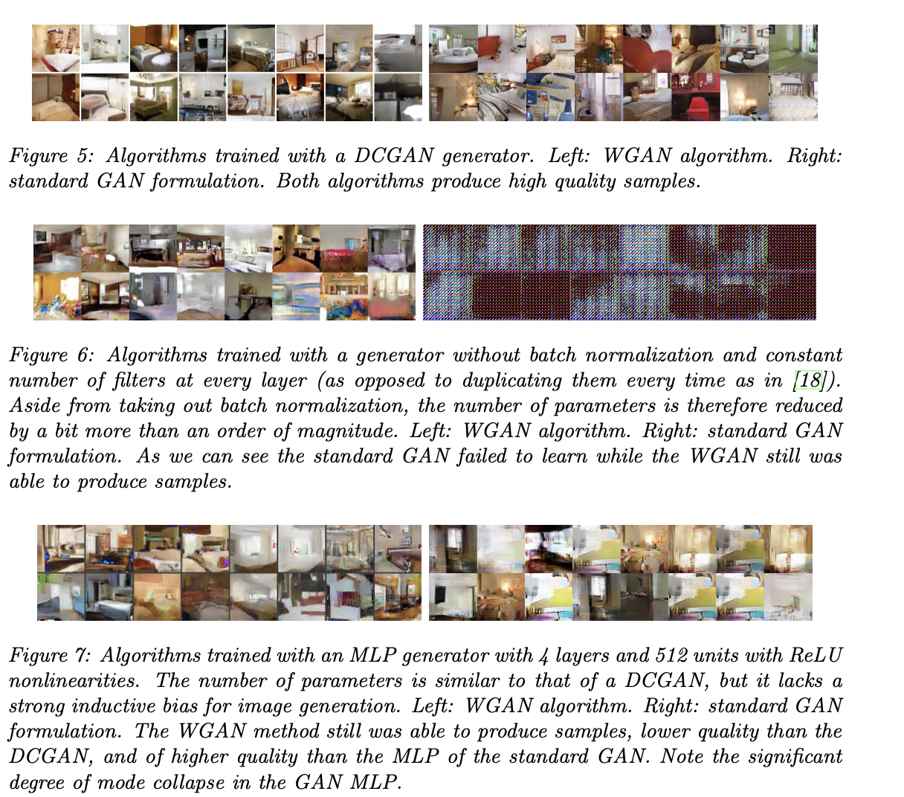
Wasserstein GAN

Slide 31
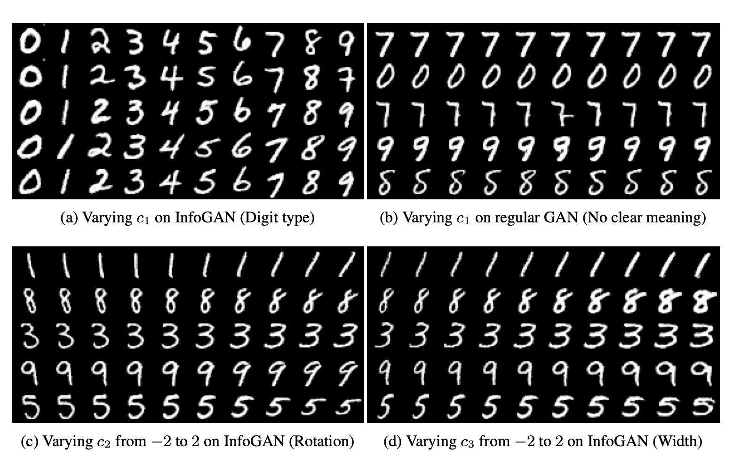
InfoGAN

